Slide 1
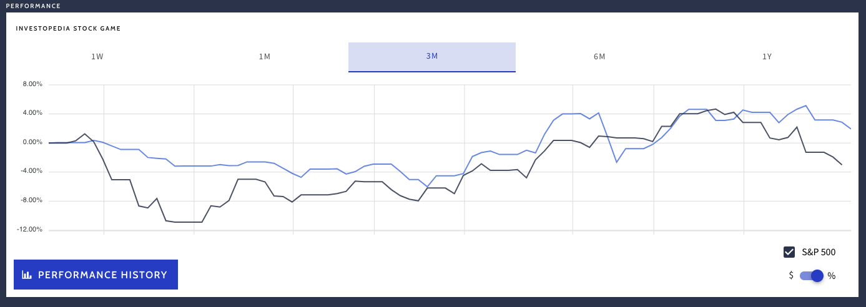
Equities
Using just RSI, MACD & merging the two into a single rule, I was able to beat the SP500 trading only 20 stocks, BUT only a 4% gain. This was done within a “simulated” trading game. I am not advocating for day trading.

Slide 2
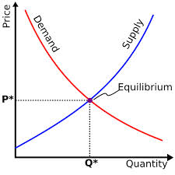
What is a Market?
Traditional Markets
Stock Markets
Bond Markets
Housing/Mortgages
Commodities – gold/silver etc
Crop Futures – corn/soybean
Consumer Credit
…
A market is one of the many varieties of systems, institutions, procedures, social relations and infrastructures whereby parties engage in exchange. Traditional markets are often regulated, have defined trading norms/rules, and have been in existence for some time.
2

Slide 3

Securities Trading can be distilled into 4 categories
Belief Based Investing
The value of a company is appealing regardless of market & financial factors. As a result, investor value perception changes trigger buy/sell action.
I like Wonder bread, so I bought stock in Flower Foods (FLO) since they make it.
https://www.steadygo.digital/blog/terrible-stock-photos/
3
Notes:
I like Netflix movies so I bought Netflix.
I don’t agree with tobacco sales so I avoid those stocks.
Warren Buffet “Buy companies you understand”

Slide 4

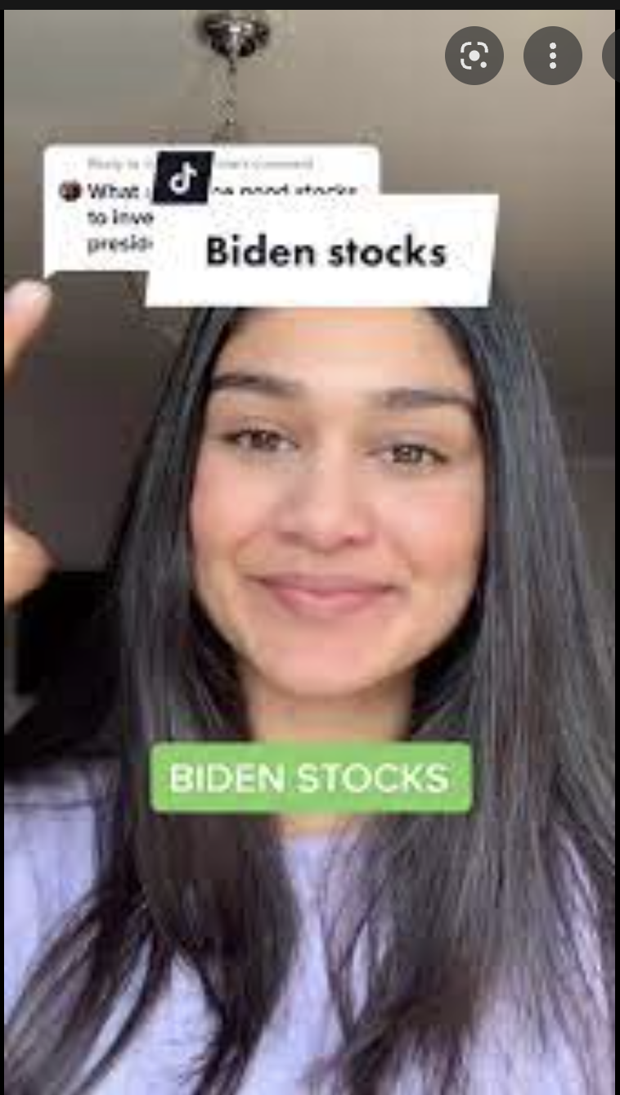

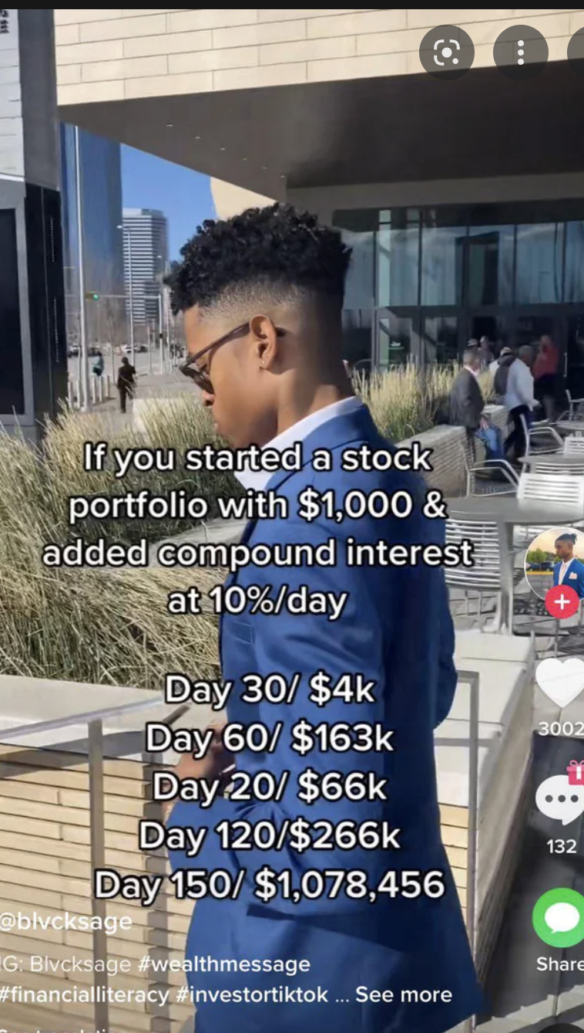
Ok so there is a new type of belief based investor…

Slide 5
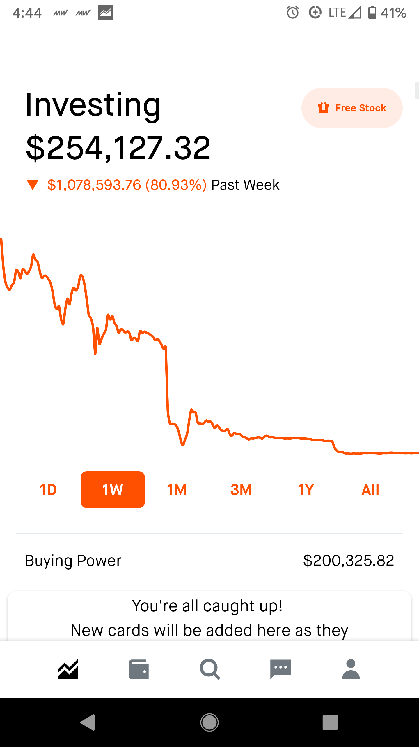
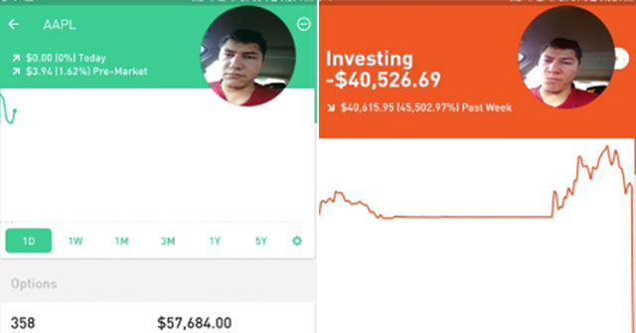
With predictable results

Slide 6

Securities Trading can be distilled into 4 categories
Financial Fundamentals Investing
Traditional financial performance indicators trigger an action regardless of sector, or company product.
Monsanto (MON) makes genetically modified food, I don’t care if it is safe. I bought the stock because the EPS is good.
6
Notes:
Reviewing an annual report and pouring over cash flow, revenue growth, expenditures like R/D all count as fundamental investing

Slide 7

Securities Trading can be distilled into 4 categories
Technical Trading
Trade based on “indications”. Uses non-financial mathematical indicators to quantify risk/reward, or trigger buy/sell
“Algorithmic Trading” – using algorithms to identify an equity action
Momentum – Recognize prices moving up/down at thresholds to trigger action
“Charting” – Visual chart patterns trigger actions (crossovers, head & shoulders)
The MACD crossover pattern for Smith & Wesson (AOBC) is positive so now is a good time to buy.
7
Notes:
Reviewing an annual report and pouring over cash flow, revenue growth, expenditures like R/D all count as fundamental investing

Slide 8
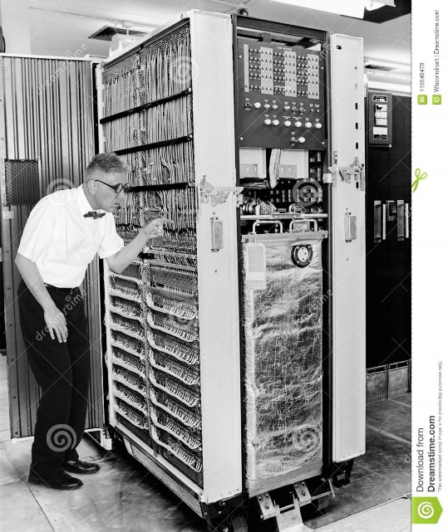

Securities Trading can be distilled into 4 categories
High Frequency Trading
Extremely technical trading executed without a human that can trigger thousands of actions measured in nano-seconds. “scalping” small profits thousands of times per minute.
1001100100…
*Although HFT uses algorithms:
>There is no human in the loop
>Primary profits derive from market making
8
Notes:
$460M

Slide 9

HFTs in a nutshell
https://www.youtube.com/watch?v=RUyM-I6_yFM&ab_channel=MarketWatch

Slide 10

Speaking of Knight Cap
A word of caution.
Notes:
$460M

Slide 11
Keep in mind for trading…
In the short term the market is a NEGATIVE sum transaction. Market “makers” make money on the transactions. Retail investors pay a commission/fee for the trade, or HFT are beating your trades to scalp profit.
Be careful & be sure to test your methods!
Notes:
$460M

Slide 12
What type?
The Stochastic Momentum Indicator (SMI), a formula for measuring momentum, crossed over to positive territory. I think I will buy Google (Alphabet).
Belief Based – some intrinsic value of the company is appealing and triggers a buy/selling action.
Fundamental Trading - traditional financial indicator triggers an action regardless of sector, or company product.
Technical Trading – trade based on “indications” or “algo trading”
High Frequency Trading – “scalping” small profits repeatedly
12

Slide 13
What type?
Our PhD physicist wrote an algorithm that trades apple stock 10,000 per minute.
Belief Based – some intrinsic value of the company is appealing and triggers a buy/selling action.
Fundamental Trading - traditional financial indicator triggers an action regardless of sector, or company product.
Technical Trading – trade based on “indications” or “algo trading”
High Frequency Trading – “scalping” small profits repeatedly
13

Slide 14
What type?
I won’t buy firearm companies.
Belief Based – some intrinsic value of the company is appealing and triggers a buy/selling action.
Fundamental Trading - traditional financial indicator triggers an action regardless of sector, or company product.
Technical Trading – trade based on “indications” or “algo trading”
High Frequency Trading – “scalping” small profits repeatedly
14

Slide 15
What type?
In our workshop we modeled the probability of risk using a decision tree and it looks like buying a consumer loan is a good investment.
Belief Based – some intrinsic value of the company is appealing and triggers a buy/selling action.
Fundamental Trading - traditional financial indicator triggers an action regardless of sector, or company product.
Technical Trading – trade based on “indications” or “algo trading”
High Frequency Trading – “scalping” small profits repeatedly
15

Slide 16
What type?
Google’s quarterly ad revenue is improving, so I am going to buy some shares.
Belief Based – some intrinsic value of the company is appealing and triggers a buy/selling action.
Fundamental Trading - traditional financial indicator triggers an action regardless of sector, or company product.
Technical Trading – trade based on “indications” or “algo trading”
High Frequency Trading – “scalping” small profits repeatedly
16

Slide 17
Bonus!
The US Government has broadly applied tariffs to every country and even unpopulated islands.
Belief Based – Do these tariffs change something you believe about the company’s business model? Let’s look at history…
Fundamental Trading - Financial indicators for multi-nationals would be impacted.
Technical Trading – the stock market is crashing, all indications are negative! Sell!!
High Frequency Trading – volatility & volume are good for us.

Slide 18
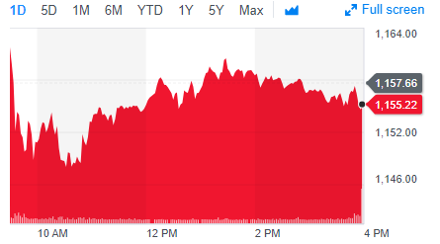
Stock Prices represent a time series
PRICE or Volume
TIME
Stock price of US Steel
18

Slide 19
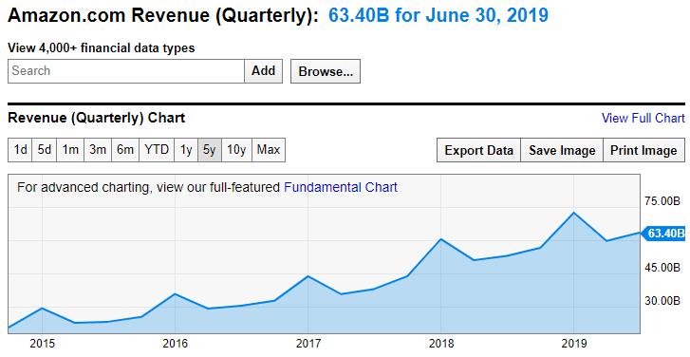
Not all times series can be forecasted
Qrtly Revenue
TIME
https://ycharts.com/companies/AMZN/revenues
This time series has a trend and seasonality so a traditional forecasting method like Holt Winters could be used.
19

Slide 20
Stock Prices represent a time series
Random Walk
VS.
Predictable Patterns (non-stock)
From a forecasting perspective stock prices are often considered a “random walk” meaning traditional econometric forecasting techniques do not apply. And stock forecasts leading to actions can affect the market, making the next forecast harder.
20

Slide 21
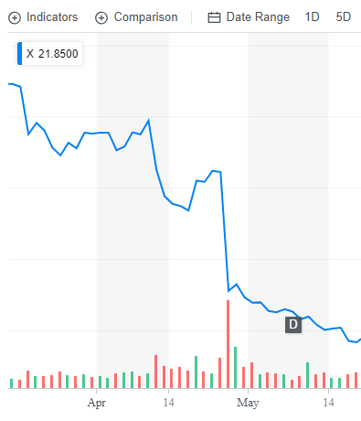
Why can’t you “forecast” the time series?
Daily Chart
U.S. Steel
Q1 Jan/Feb/Mar plus ~30 days for reporting
4/25/17 Close : $31
4/26/17 Close: $22
4/26/17 Volume spike
21

Slide 22
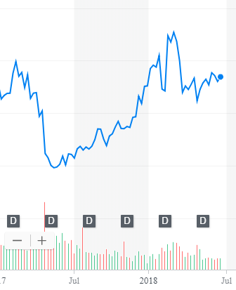
What other forces can impact US Steel?
Weekly Chart
U.S. Steel
4/25/17 Close : $31
4/26/17 Close: $22
4/26/17 Volume spike
5/15/17: ~$20
2/26/18: ~$45
Missed Qrtly Earnings &
Dumped chemicals into a waterway [epa fines]
22

Slide 23
What other forces can impact US Steel?
Weekly Chart
U.S. Steel
4/25/17 Close : $31
4/26/17 Close: $22
4/26/17 Volume spike
5/15/17: ~$20
2/26/18: ~$45
4/16/18: ~$36
6/16/18: ~36
Missed Qrtly Earnings
Steel tariffs
23

Slide 24
What other forces can impact US Steel?
Weekly Chart
U.S. Steel
4/25/17 Close : $31
4/26/17 Close: $22
4/26/17 Volume spike
5/15/17: ~ $20
2/26/18: ~ $45
4/16/18: ~ $36
6/16/18: ~ $36
Missed Qrtly Earnings
Steel tariffs
Retaliatory Auto tariffs
24

Slide 25
So forecasting (pattern recognition) methods won’t work.
Weekly Chart
U.S. Steel
Missed quarterly earnings (self inflicted)
Steel Tariffs (political/macro)
Auto Tariffs (out of sector performance)
External factors remove pattern recognition that econometric forecasts seek.
25

Slide 26
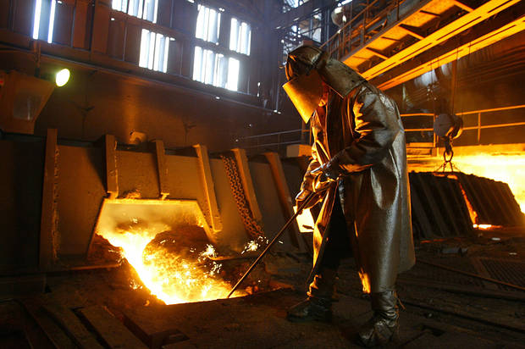


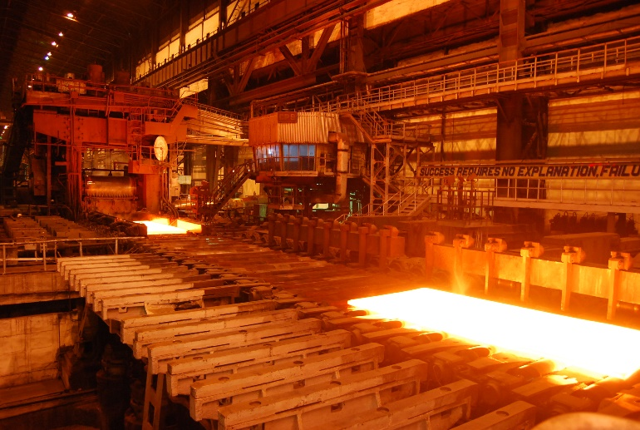
Meanwhile, US Steel was... producing steel.
A belief investor would not have bought or sold.
26

Slide 27
Meanwhile, US Steel was... producing steel.
A fundamental investor would have sold after the quarterly earnings report waiting for another financial indicator to buy again (next quarter).
27

Slide 28
Meanwhile, US Steel was... producing steel.
A technical investor may have gotten out after the price drop but back in as positive moment based on steel tariffs occurred only to sell again after the momentum faded based on automotive tariffs
28

Slide 29
Meanwhile, US Steel was... producing steel.
An HFT would have been in and out many times per second and minute making money no matter the direction, they work only with speed as an advantage.

Slide 30
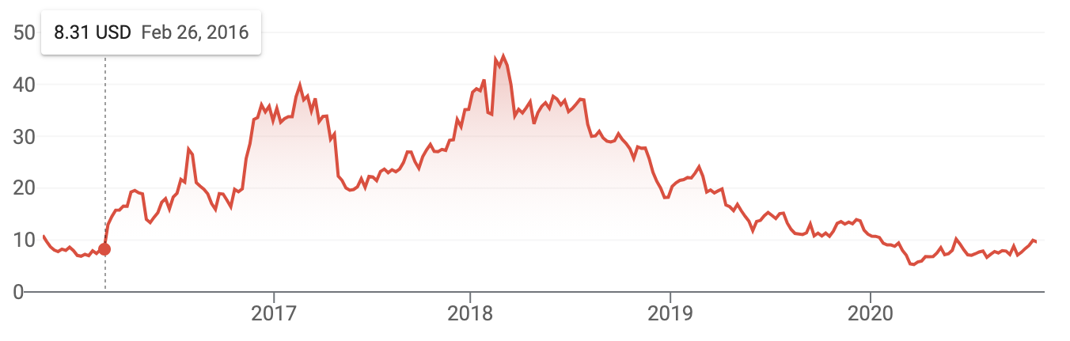
US Steel Update: Pandemic Fearful Economic Panic & Uncertainty
Steel Tariff & Trade War as discussed.
US Steel Update: Declining Impact of Trade War & Expected “Soft Landing” Recession
Pandemic Dip and Uncertainty

Slide 31
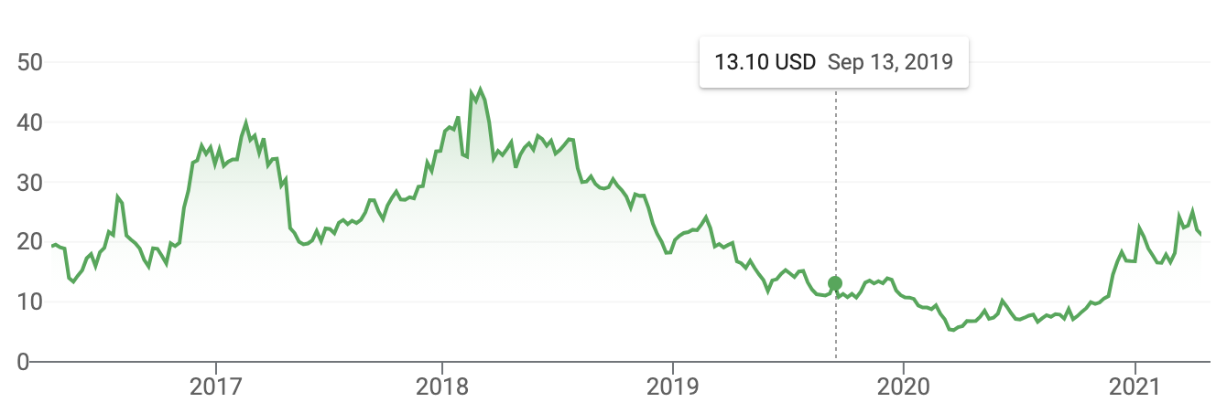
Looks like a positive momentum? Improving US economy, infrastructure bill

Slide 32
What is an example of a stock that has been impacted by macroeconomic forces?

Slide 33
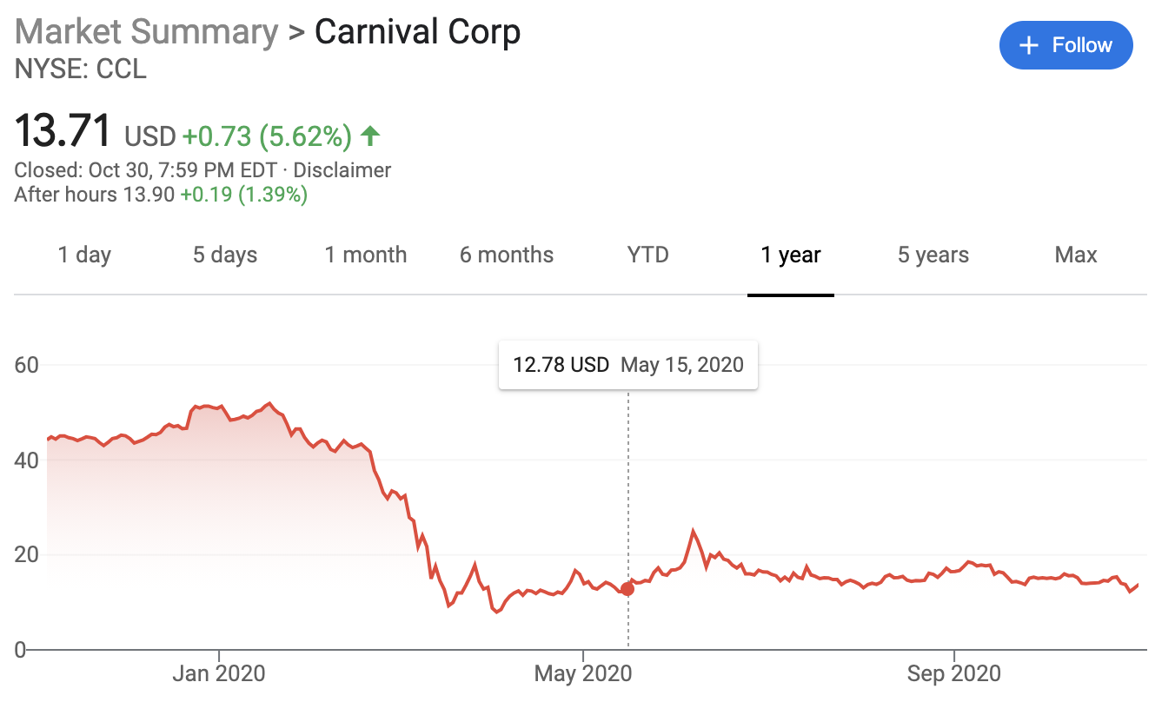
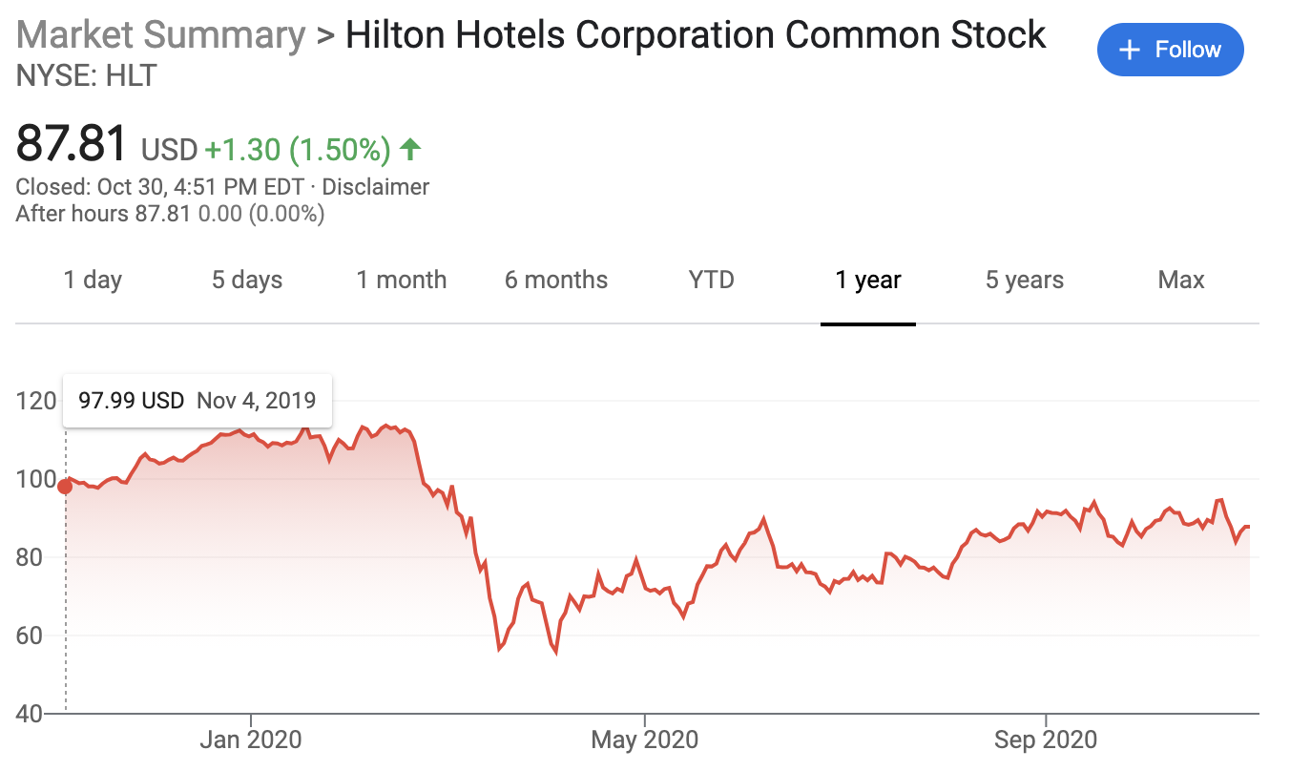
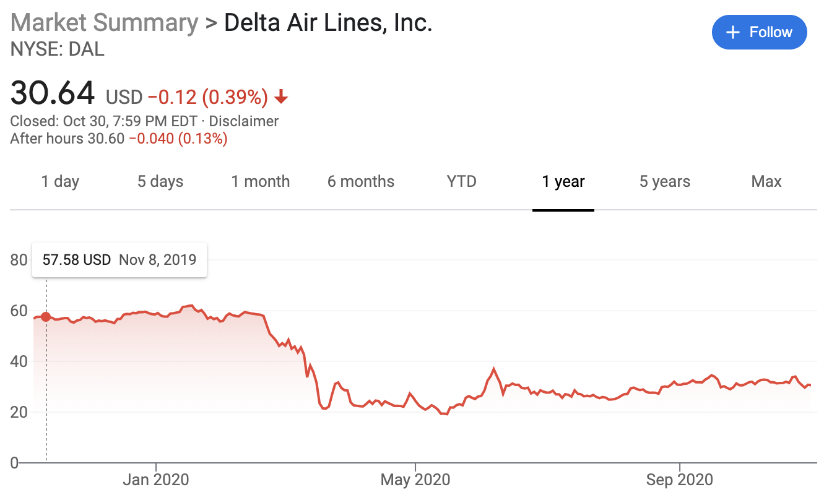
What is an example of a stock that has been impacted by external forces?

Slide 34
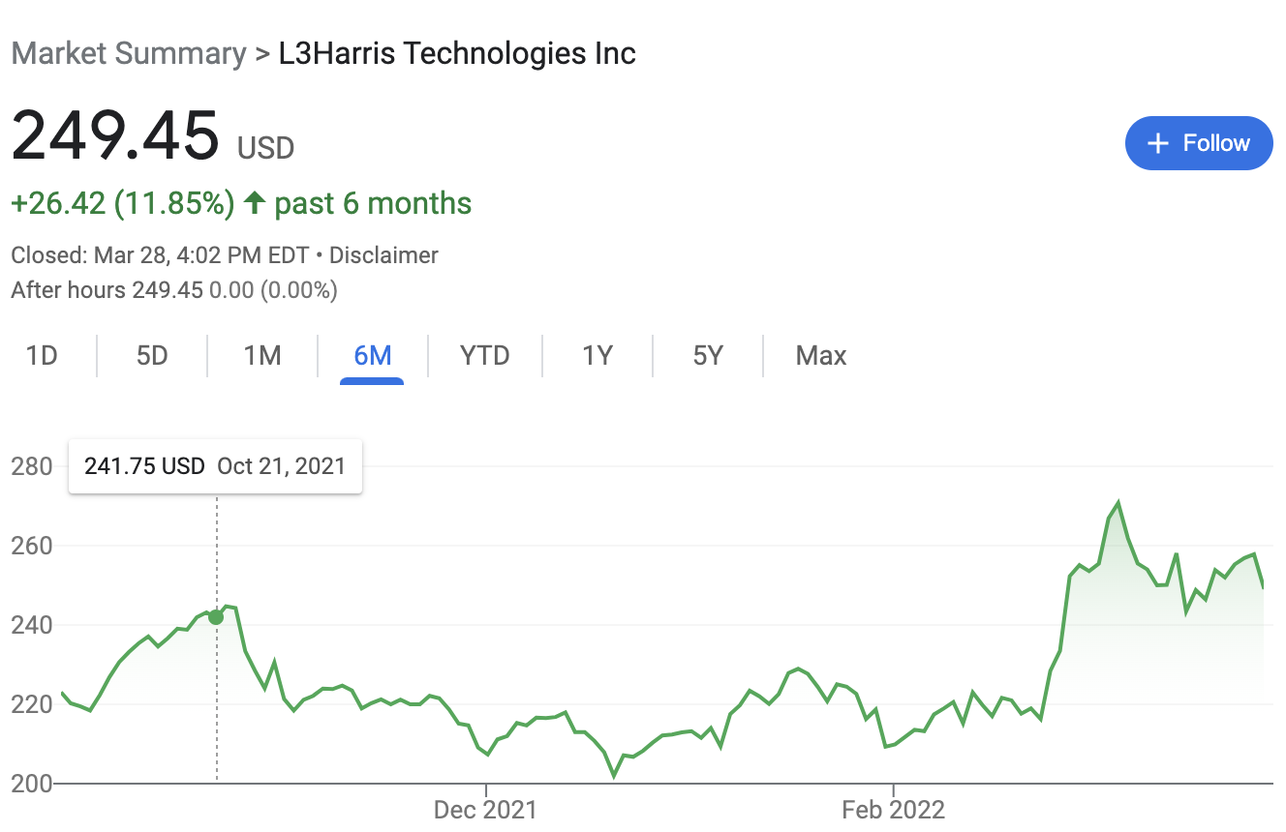
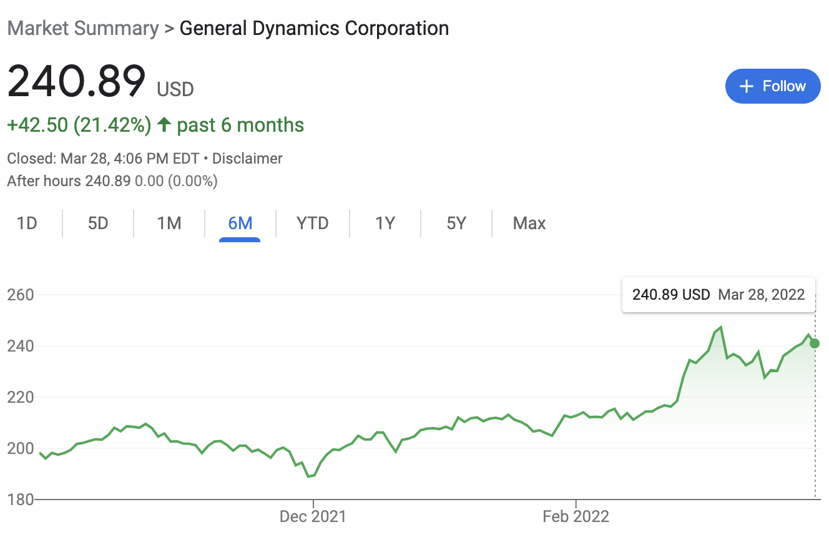
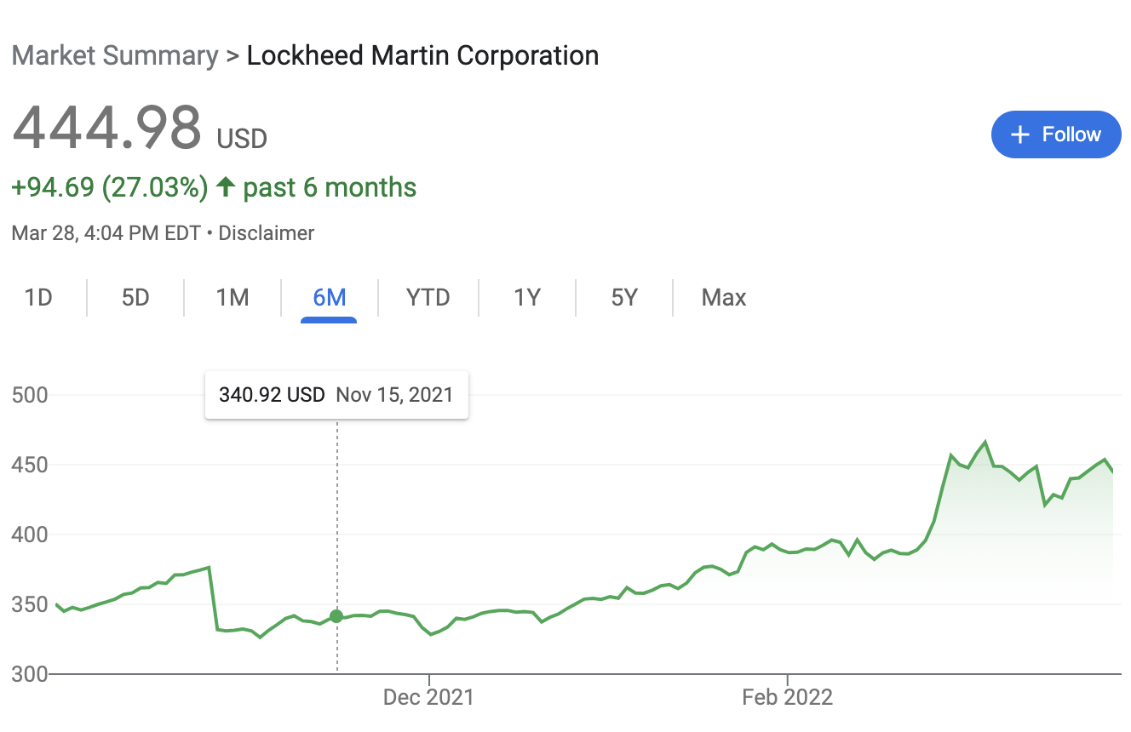
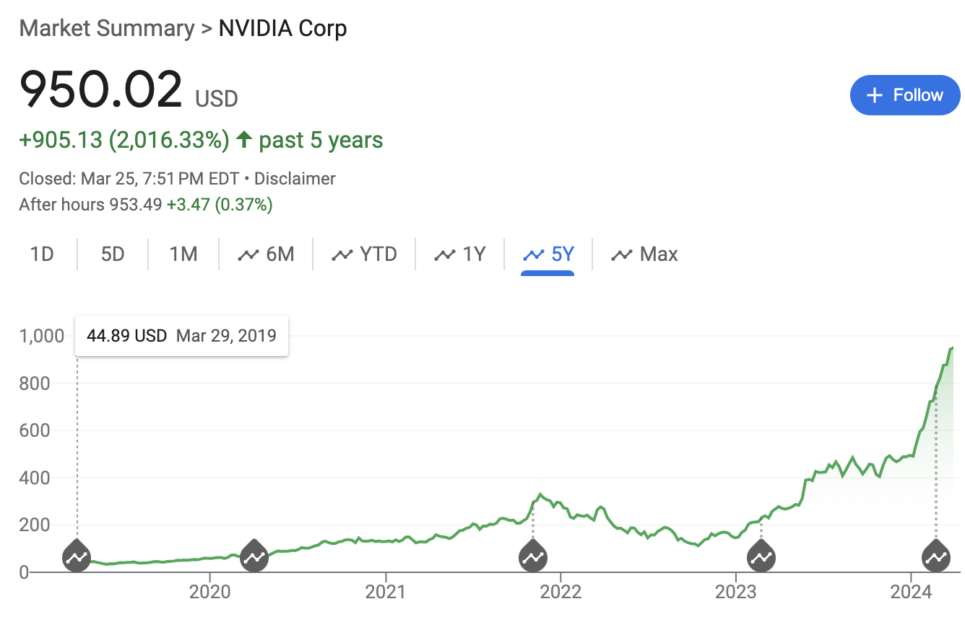

Slide 35
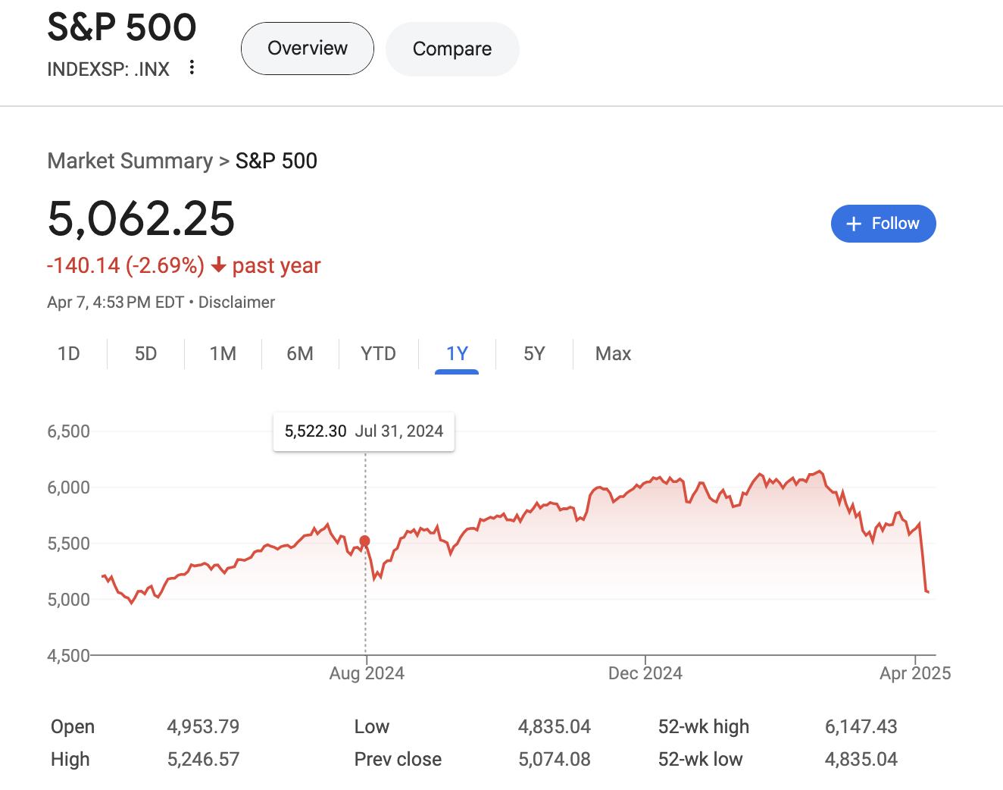
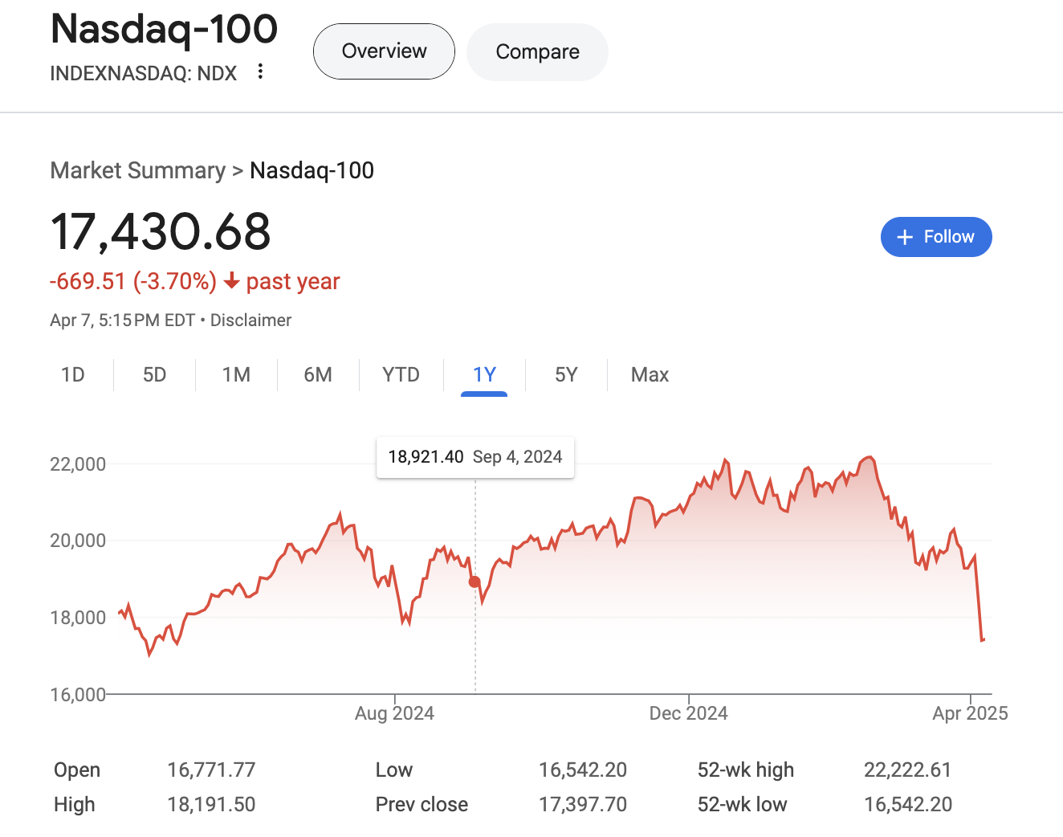
And now recent tariffs have also impacted the market.

Slide 36



R has many API related libraries.
Quantmod handles the request & organizing data to a time series object.
Rather than code requests & parse responses ourselves we use the quantmod package.

Slide 37
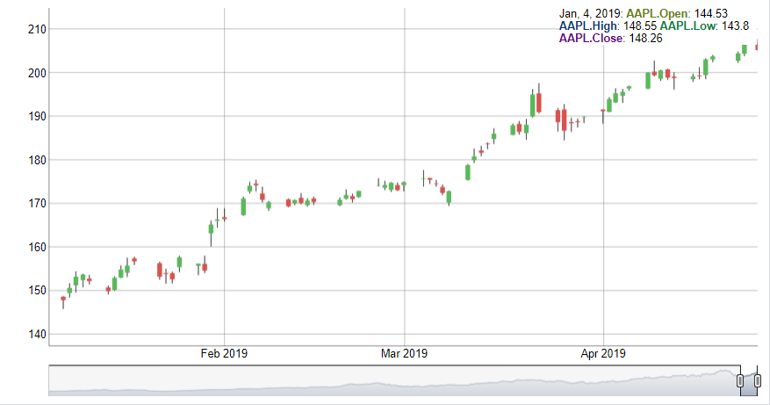
Interpreting a Candlestick Chart
Down Day
Up Day
High Price
High Price
Opening Price
Closing Price
Closing Price
Opening Price
Low Price
Low Price

Slide 38
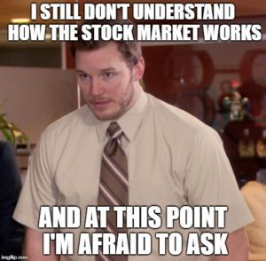
Let’s Practice! Open A_TTR.R
Learning Objective:
Get real stock data
Subset an xts object
Plot the time series dynamically
38

Slide 39
Technical traders use “indicators” to trigger actions.
1. Indicator:
If the daily Rishi Sunak quotes of “economic recovery” is greater than 5,
then buy (or hold) WLTW (Willis Towers Watson) the next day.
2. Back-testing:
In the last 180 days, this indicator has yielded a 6% return [fictitious]
3. In Production:
Set up a script to monitor Rishi’s “economic recovery” quotes and buy or hold if the number is greater than 5.
4. Execution:
In any given day that has quotes > 5 buy WLTW otherwise have no position.
5. Continual Monitor:
If you are in WLTW and quotes is < 5, then sell and vice versa.

Slide 40
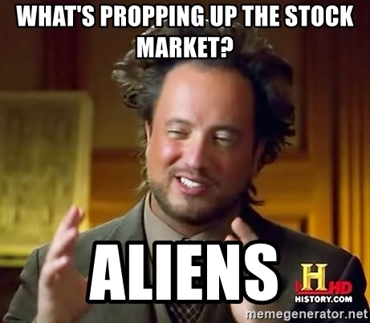
Technical Trading Assumptions
“what” > “why”
Price action > reasons for move (non-explanatory)
Technical traders don’t necessarily care why a price changes.
40

Slide 41
Technical Trading Assumptions
“what” > “why”
Price action > reasons for move (non-explanatory)
Known information is already reflected in the price.
Technical traders believe tradeable information is immediately embedded in the price (not worth the effort to “scalp” i.e. trade based on speed or acting on info before others ).
41

Slide 42
Technical Trading Assumptions
“what” > “why”
Price action > reasons for move (non-explanatory)
Known information is already reflected in the price.
Buyers & sellers trade based on emotion.
Fear & greed are powerful forces
Technical traders realize that some amount of trades occur due to emotion. Technical traders are unemotional when trading thereby exploiting the emotional traders.
42

Slide 43
Technical Trading Assumptions
“what” > “why”
Price action > reasons for move (non-explanatory)
Known information is already reflected in the price.
Buyers & sellers trade based on emotion.
Fear & greed are powerful forces
Markets fluctuate.
For technical traders to be successful, there needs to be pricing volatility.
43

Slide 44
Let’s zoom into Technical Trading Rules (TTR)
Our learning goal is to use and understand some of the common technical indicators which affect you as a saver, pension holder, stock trader etc.
Further research is needed to be successful.
Our learning goal is NOT to make you a trader or convince you that you are now qualified to be a technical trader.
44

Slide 45
In addition to quantmod we will use TTR (technical trading rules)
library(TTR)
SMA() #simple moving average
MACD() #moving avg convergence/divergence
RSI() #Relative Strength Index
For expediency we will cover simple indicators but there are many more and you could even develop your own.
45

Slide 46
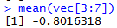
What is a moving average?
vec[1:15]
[1,] -11.070657
[2,] 3.774292
[3,] 11.844412
[4,] -22.456977
[5,] 5.291247
[6,] 6.060559
[7,] -4.747400
[8,] -4.466319
[9,] -4.644520
[10,] -7.900378
[11,] -3.771927
[12,] -8.983864
[13,] -6.762539
[14,] 1.644588
[15,] 10.594941
A smoothing technique reducing noise in a data series. Takes the average over “n” number of periods.
46

Slide 47
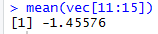
What is a moving average?
vec[1:15]
TTR::SMA(vec[1:15], n=5)
[1,] -11.070657
[2,] 3.774292
[3,] 11.844412
[4,] -22.456977
[5,] 5.291247
[6,] 6.060559
[7,] -4.747400
[8,] -4.466319
[9,] -4.644520
[10,] -7.900378
[11,] -3.771927
[12,] -8.983864
[13,] -6.762539
[14,] 1.644588
[15,] 10.594941
[1,] NA
[2,] NA
[3,] NA
[4,] NA
[5,] -2.5235367
[6,] 0.9027066
[7,] -0.8016318
[8,] -4.0637779
[9,] -0.5012865
[10,] -3.1396115
[11,] -5.1061087
[12,] -5.9534017
[13,] -6.4126457
[14,] -5.1548241
[15,] -1.4557603
A smoothing technique reducing noise in a data series. Takes the average over “n” number of periods.
47

Slide 48

So how does SMA become an Indicator?
Red Card! We need to lag the trading rule to ensure the signal is realistic. Calculations are not real time, but at the day’s close so you need to adjust the results to emulate a real scenario.
48

Slide 49
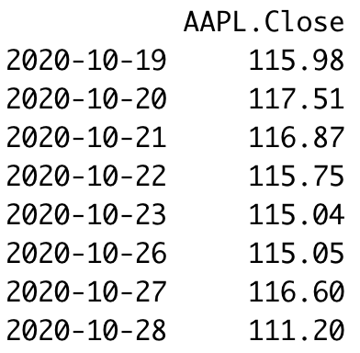
Why Lag? Version 1
Our Indicator:
“Buy if the previous day closing price was >$115 & sell if <$115
End of Closing Oct 19: Buy when the market opens Oct 20
End of Closing Oct 27: Hold because the price is >115. You even hold Oct 28 all day because the indication is closing day price. At the end of Oct 28, the indication triggers at $111. You sell on Oct 29.
Because there is a lag for acting on the trigger, you move all data down by one period.
49

Slide 50
Why Lag? Version 2
Day 1 you have a closing price at 4:00pm EST
Day 2 you have a closing price at 4:00pm EST
Day 3 you have a closing price at 4:00pm EST
Day 4 you have a closing price at 4:00pm EST
Day 5 you have a closing price at 4:00pm EST
Day 6 at 9:30AM is the earliest you could trade using the 5 day MA.
As a result you have to move the results of the calculation ”down” 1 day because that is when you would have it for use (day6)
Now you have 5 complete data points to calculate the moving average.
*setting aside futures/after hours

Slide 51
Open B_TTR.R
Learning Objective:
Get real stock data
Subset an xts object
Create three simple moving averages and plot to see the smoothing effect
51

Slide 52
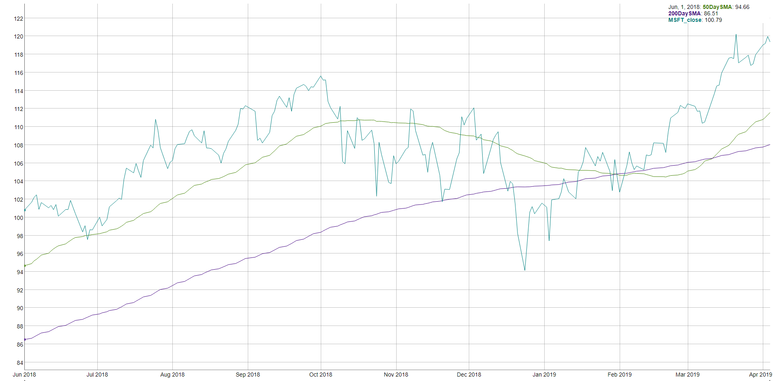
How does SMA become an indicator? MSFT 50 & 200 day SMA
“Golden Cross”
“Death Cross”

Slide 53
How does SMA become an indicator? MSFT 50 & 200 day SMA
“Golden Cross”
“Death Cross”
200 day: 9.5 months of trading
50 day: ~2.4 months of trading
Indicator Information
If the 50day average is > than the 200day then money is moving into the stock. Converse is True.

Slide 54
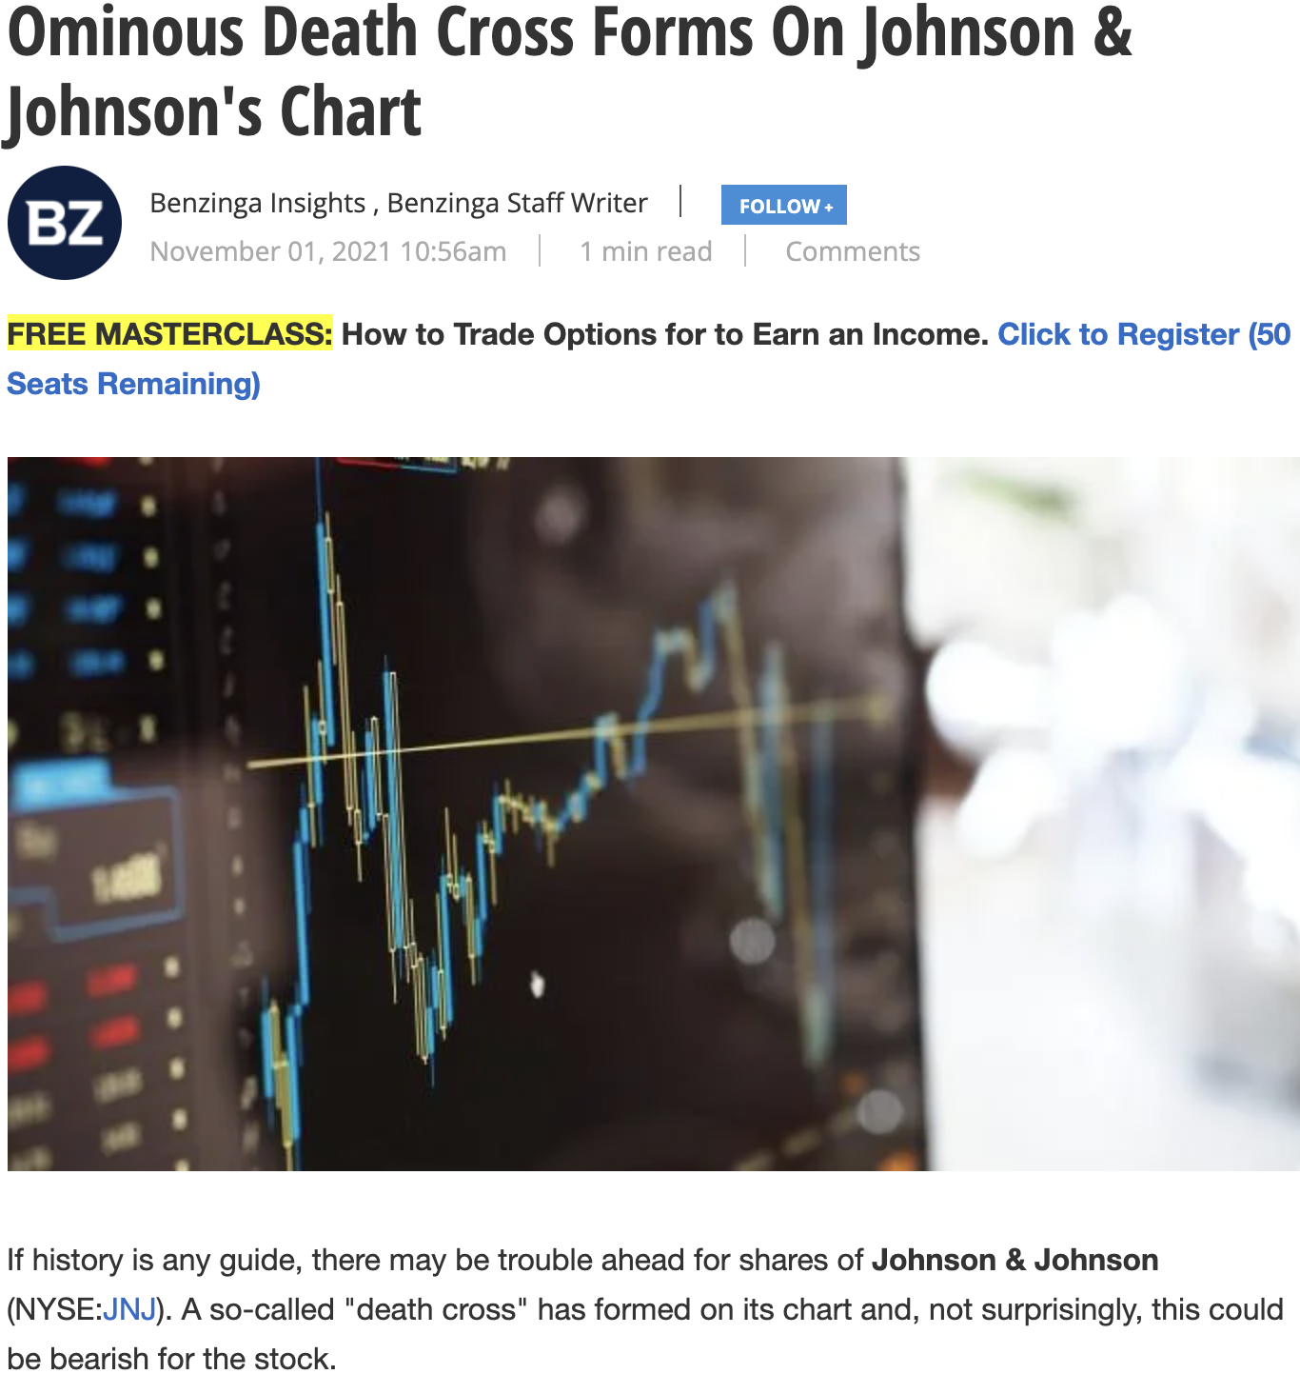
Do people really use SMA?
https://www.benzinga.com/markets/21/11/23791953/ominous-death-cross-forms-on-johnson-johnsons-chart

Slide 55
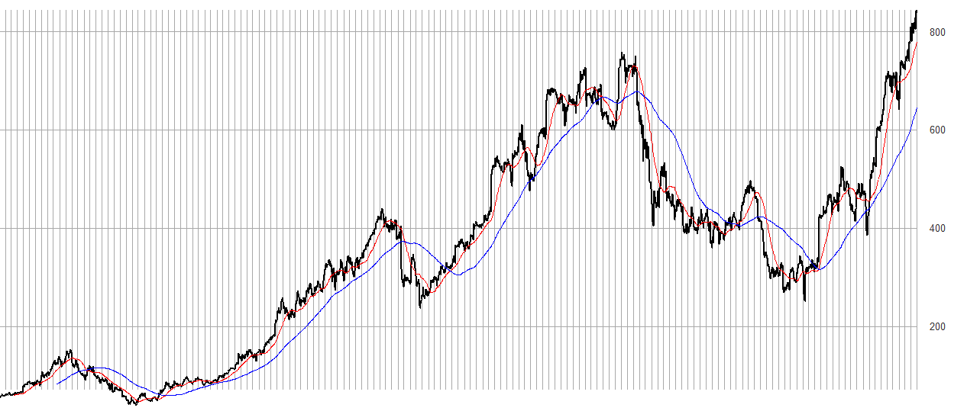
Once you have an indicator you must test it.
An investor can “backtest” the strategy to find an acceptable “n” in case 50/200 doesn’t work. Once the best “n” is found, an investor can look for “crosses” to indicate buy/sell.

Slide 56
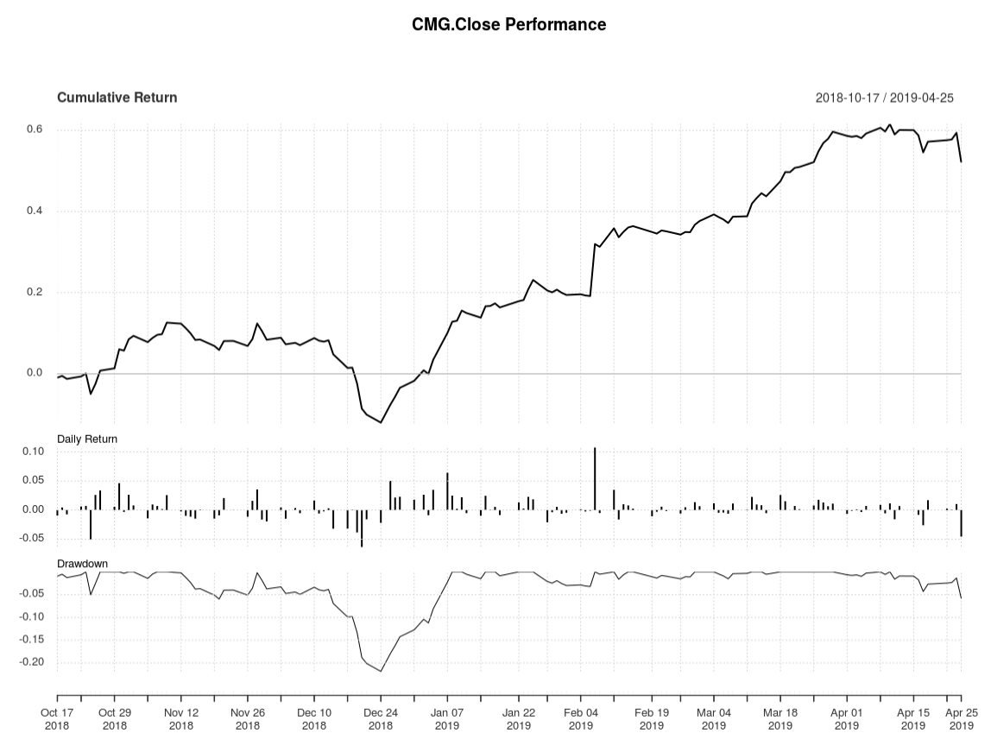
Interpreting the Rate of Change (ROC)
Total Cumulative Return using the rule.
Day to Day Return
Important if rule is sub one day periodicity or if one day of wild swings affects outcome
Peak to trough % change, used to understand volatility and a maximum you might lose when its not going well.
SMA as an Indicator for CMG as shown in a performance chart.
56
Notes:
Peak to trough analysis is a measure of volatility and often used in intraday. A good resource is http://www.pring.com/articles/article7.htm

Slide 57

Open C_TTR_50Day_200Day_SMA.R
Learning Objective:
Get real stock data
Subset an xts object
Calculate SMA 50 & 200
Create a trading indicator (rule)
Lag the Rule
Back-test the lagged rule to see cumulative returns
Switch a single character in the rule & back-test again to see the impact like Knight Capital
57

Slide 58
Moving Average Convergence Divergence
By measuring the moving average of two moving averages with different time frames, an investor hopes to capture when momentum is building or receding.

Slide 59

Moving Average Convergence Divergence
Money is moving into a stock…let’s jump on the upswing!
Money is moving away from a stock…let’s sell!

Slide 60
Moving Average Convergence Divergence
Instead of SMA’s “n”:
nFast(12) – the smaller window to measure (12 periods)
nSlow(26)- the longer window to measure (26 periods)
nSig(9)- the number of periods used to measure the avg difference “signal”
60

Slide 61
Moving Average Convergence Divergence
Instead of SMA’s “n”:
nFast(12) – the smaller window to measure (12 periods)
nSlow(26)- the longer window to measure (26 periods)
nSig(9)- the number of periods used to measure the avg difference “signal”
Calculate the 12 (nFast) day & 26 (nSlow) day moving averages.
Calculate the difference between averages from the previous step
Calculate the 9 day Moving Avg (nSig) of the previous step
61

Slide 62
Moving Average Convergence Divergence
Instead of SMA’s “n”:
nFast(12) – the smaller window to measure (12 periods)
nSlow(26)- the longer window to measure (26 periods)
nSig(9)- the number of periods used to measure the avg difference “signal”
Calculate the 12 (nFast) day & 26 (nSlow) day moving averages.
Calculate the difference between averages from #1 (in R it’s the MACD column)
Calculate the 9 day Moving Avg (nSig) of #2
When MACD output of #2 > Signal, the price is accelerating, positive momentum/money is coming to the equity which represents a buying opportunity. Converse is true.
62

Slide 63
Open D_TTR.R
Learning Objective:
Get real stock data
Subset an xts object
Calculate MACD
Plot a dynamic graph of the closing & MACD indicator
Visually inspect the results of buy/sell actions
Calculate cumulative return for the indicator
63

Slide 64
As a momentum indicator…
MACD captures when the market is moving positively or negatively towards an equity. When emotional sentiment is positive or negative.
MACD does not “Buy Low & Sell High” It’s buy high and sell higher!
MACD will not identify the market low point or high point exactly. So the returns will never be 100% of the possibility.

Slide 65
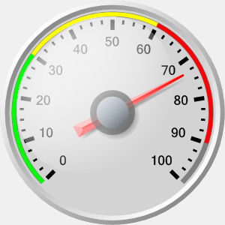
Relative Strength Index (RSI)
Momentum Oscillator
Index between 0-100
Compares average gains and losses in 14 day periods (“n”)
Usually interpreted as an overbought/oversold (over 70 / below 30)
* Usually uses EMA but we will do SMA.
65

Slide 66
Creates a control chart.
Potential Entry point
but still weaking
70
Sell
overbought
Weakening Demand
RSI
Hold
Entering oversold
oversold
30
Buy-strengthening demand
Buy
TIME
When the RSI dips below a threshold (30) the stock is considered “oversold” meaning the market has overreacted indicating a buying opportunity. RSI greater than 70 indicates the market is over buying the stock so it may be good to exit your position.
66

Slide 67
First the Relative Strength
RS = Avg Gain / Avg Loss
Avg Gain = For “up” days, total number of points up / number of “up” days (14 trading days)
Avg Loss = For “down” days, total number of points down/ number of “down” days (14 trading days)
67

Slide 68
Calculating the RSI
RSI = 100 - (100 / 1+RS)
Where RS is a ratio of avg up over avg loss in the last 14 days:
RS = Avg Gain / Avg Loss
Avg Gain = For “up” days, total number of points up / number of “up” days (14 trading days)
Avg Loss = For “down” days, total number of points down/ number of “down” days (14 trading days)
68

Slide 69
Neutral RS
Avg Gain = 10 of the last 14 days, the stock went up 1 point per day (10 points)
10 points UP / 10 UP days = 1
RS = Avg Gain / Avg Loss
Avg Loss = 4 of the last 14 days, the stock went down 1 point per day (4 points)
4 points DOWN / 4 DOWN days = 1
RS = (10/10)/ (4/4)
RS = 1

Slide 70
Neutral RSI
RS = 1
RSI = 100 - (100 / 1+RS)
RSI = 100 - (100 / 1+1)
100 – (100/2)
100 – 50
50 (neutral)

Slide 71
Overbought RS
Avg Gain = 10 of the last 14 days, the stock went up 100 points,
100 points UP / 10 UP days = 10
RS = Avg Gain / Avg Loss
Avg Loss = 4 of the last 14 days, the stock went down 4 points,
4 points DOWN / 4 DOWN days = 1
RS = (100/10)/ (4/4)
RS = 10/1

Slide 72
Overbought RSI
RS = 10
RSI = 100 - (100 / 1+RS)
RSI = 100 - (100 / 1+10)
100 – (100/11)
100 – 9.09
90.9 (overbought)

Slide 73
Oversold RS
Avg Gain = 10 of the last 14 days, the stock went up 5 points,
5 points UP / 10 UP days = .5
RS = Avg Gain / Avg Loss
Avg Loss = 4 of the last 14 days, the stock went down 40 points,
40 points DOWN / 4 DOWN days = 10
RS = (5/10)/ (40/10)
RS = 0.5/4
RS = .125

Slide 74
Oversold RSI
RS = .125
RSI = 100 - (100 / 1+RS)
RSI = 100 - (100 / 1+.125)
100 – (100/1.125)
100 – 88.8
11 (oversold)

Slide 75
Open E_TTR.R
Learning Objective:
Get real stock data
Calculate RSI
Plot a dynamic graph of the closing & RSI indicator
Visually inspect the results of buy/sell actions
If you want to try this from a more advanced perspective check out this blog:
https://lf0.com/post/understanding-ttr-package/technical-trading-rules/
75

